Slide 1
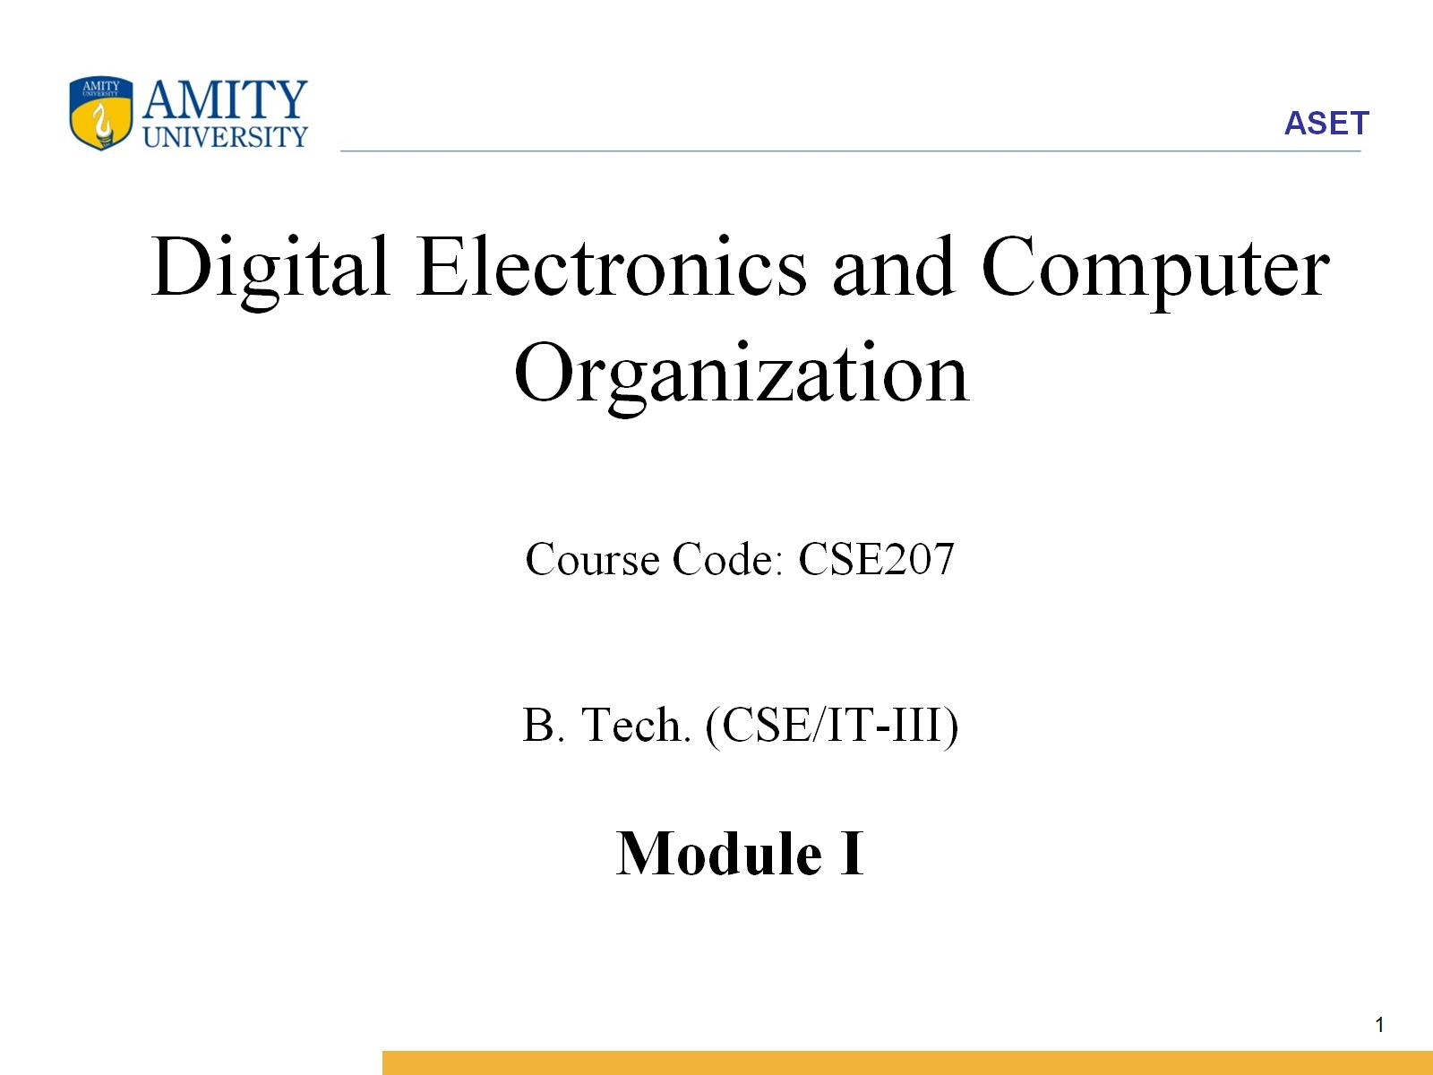
Digital Electronics and Computer Organization Course Code: CSE207 B. Tech. (CSE/IT-III) Module I

Slide 2
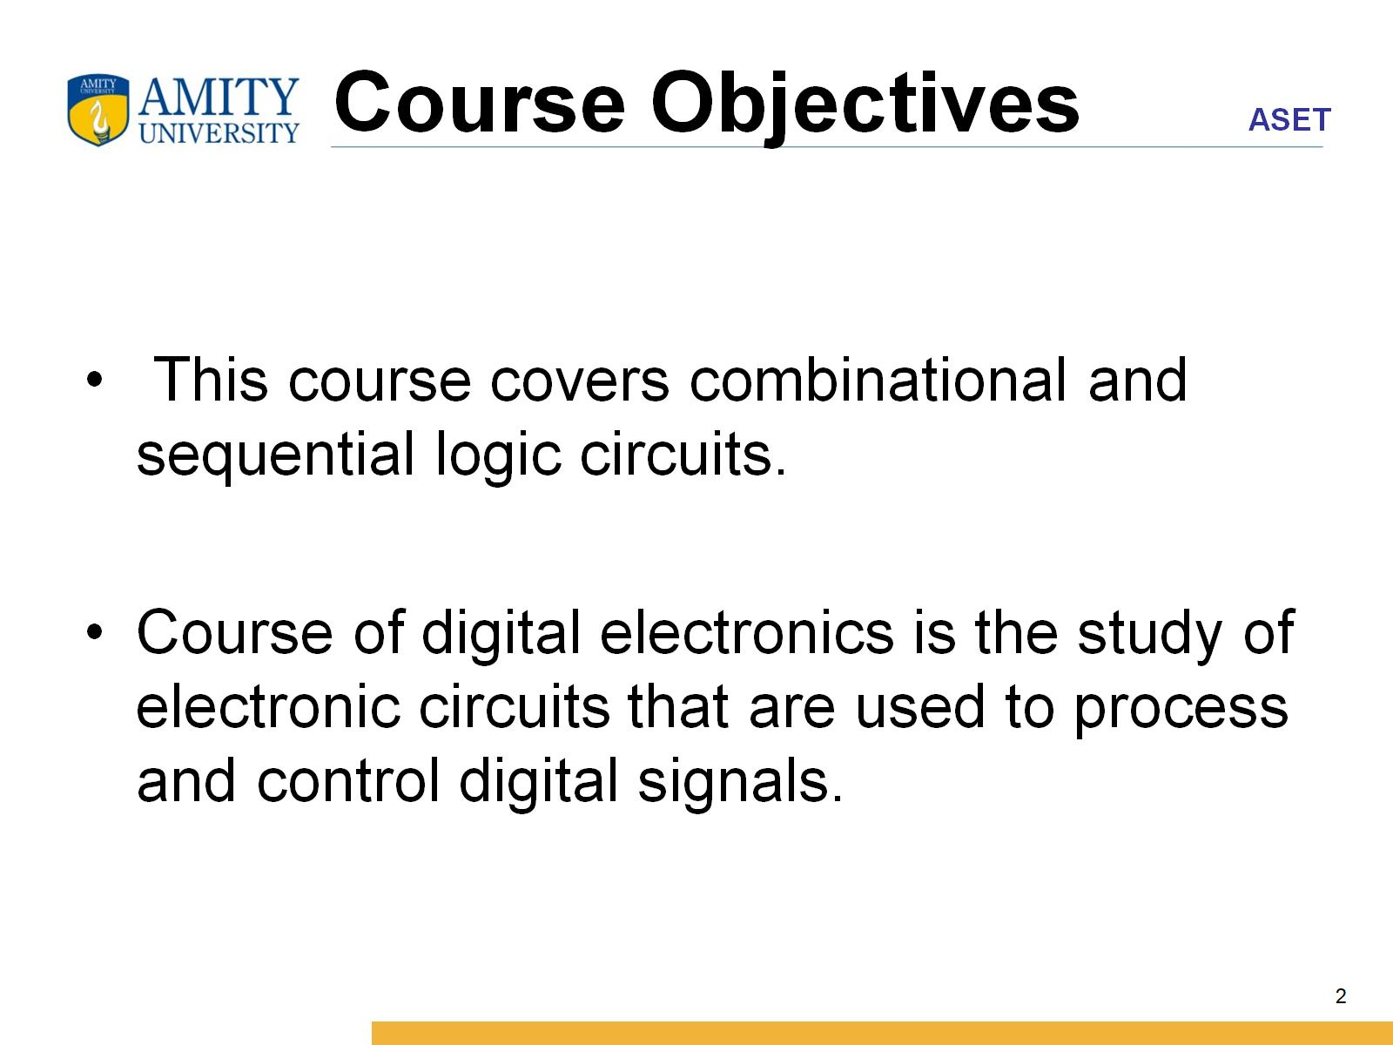
Course Objectives

Slide 3
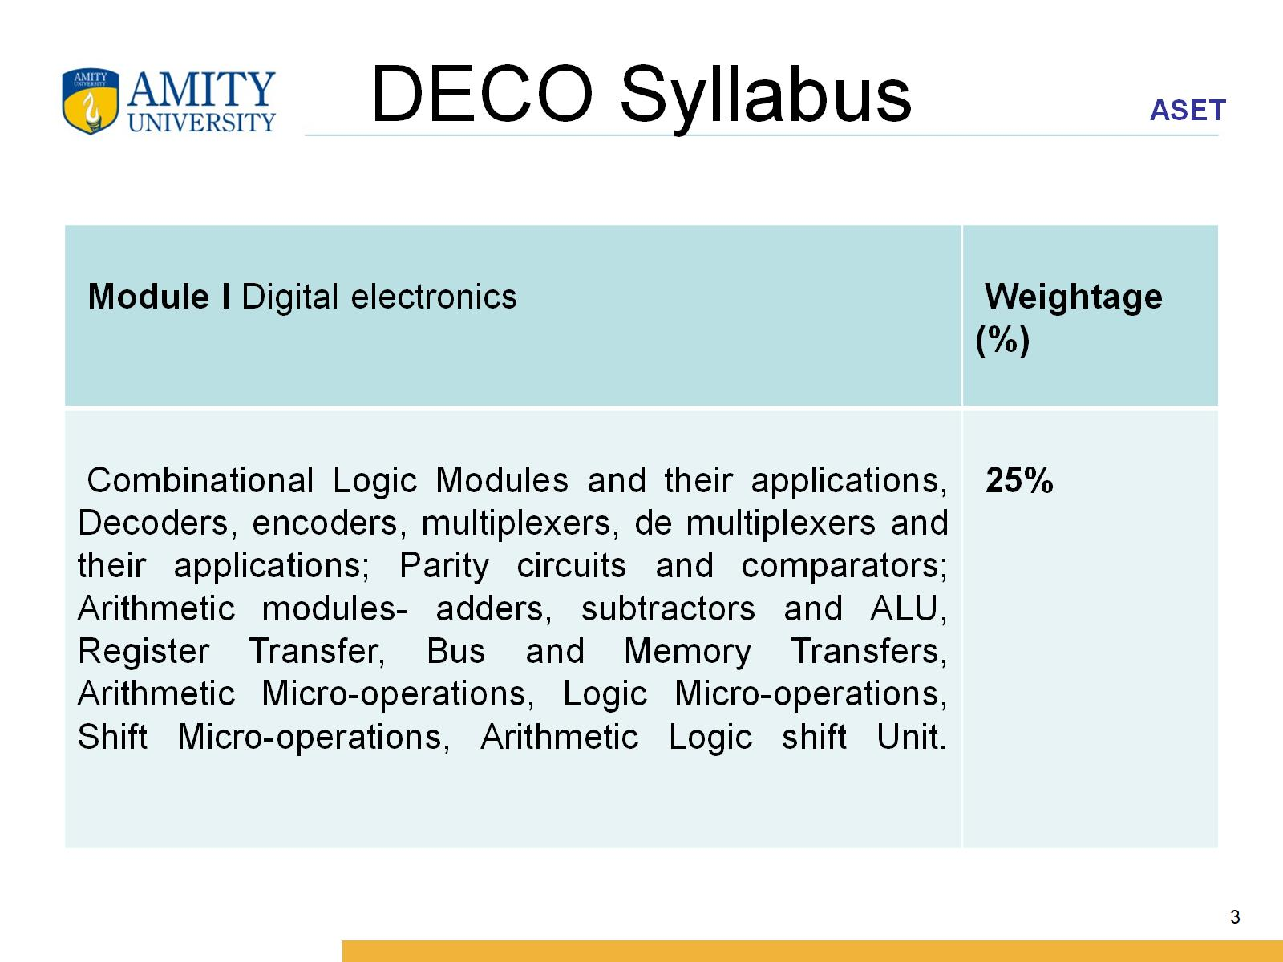
DECO Syllabus

Slide 4
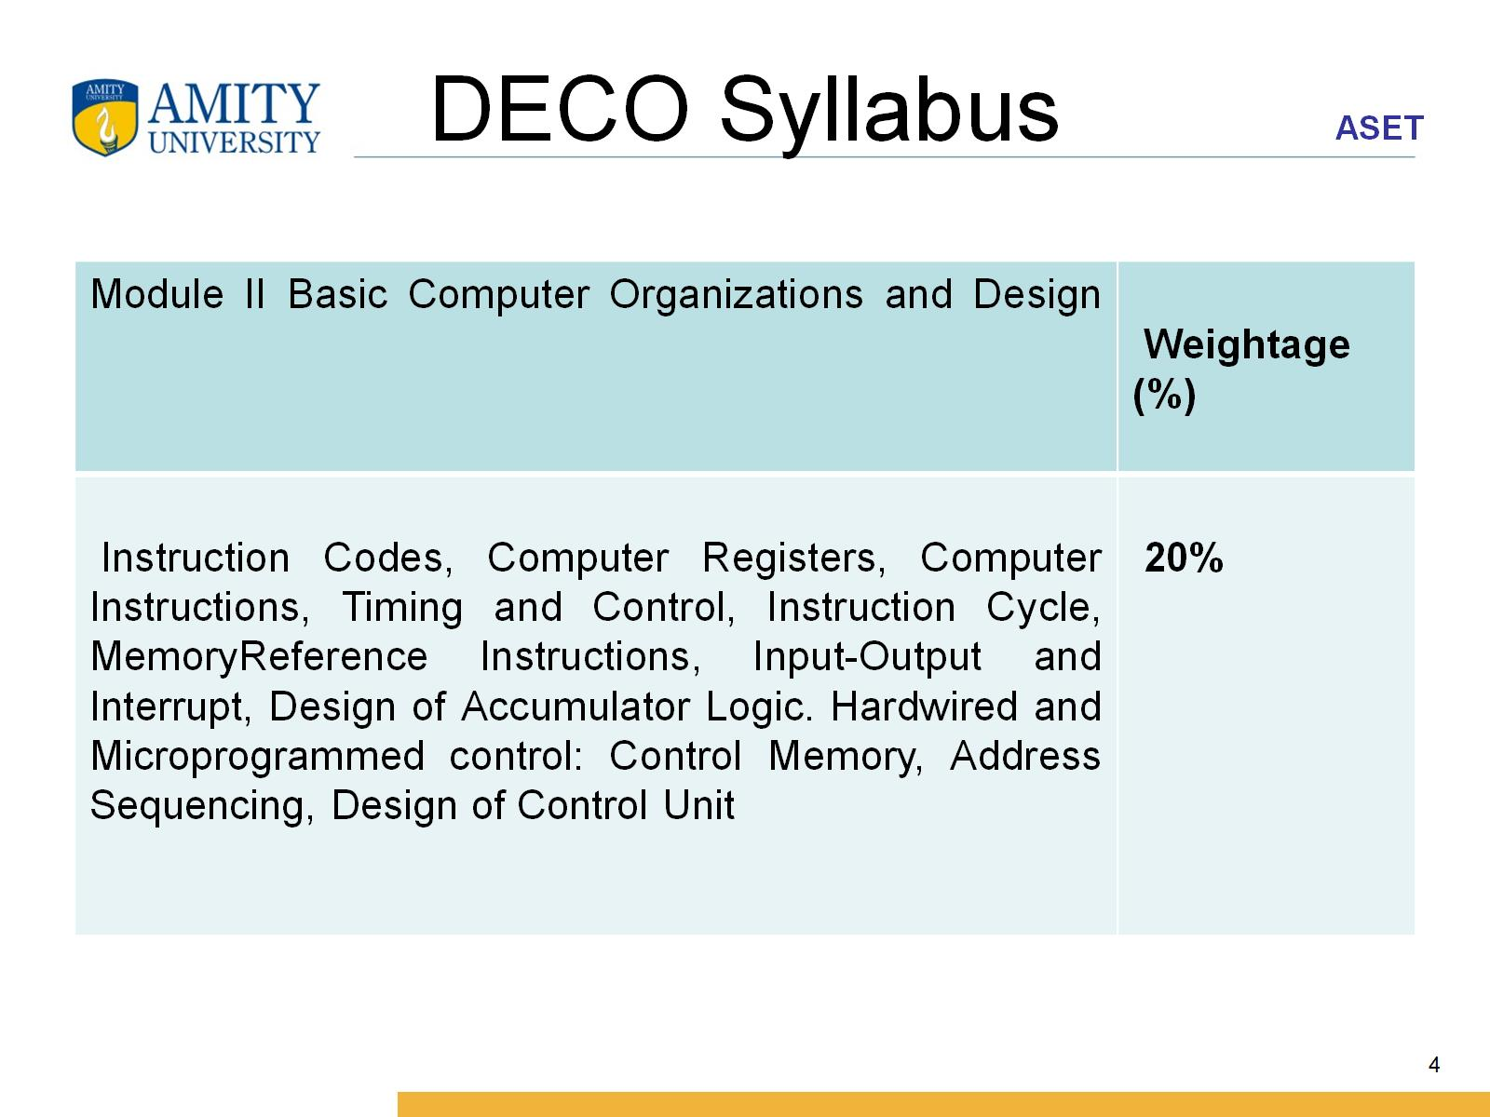
DECO Syllabus

Slide 5
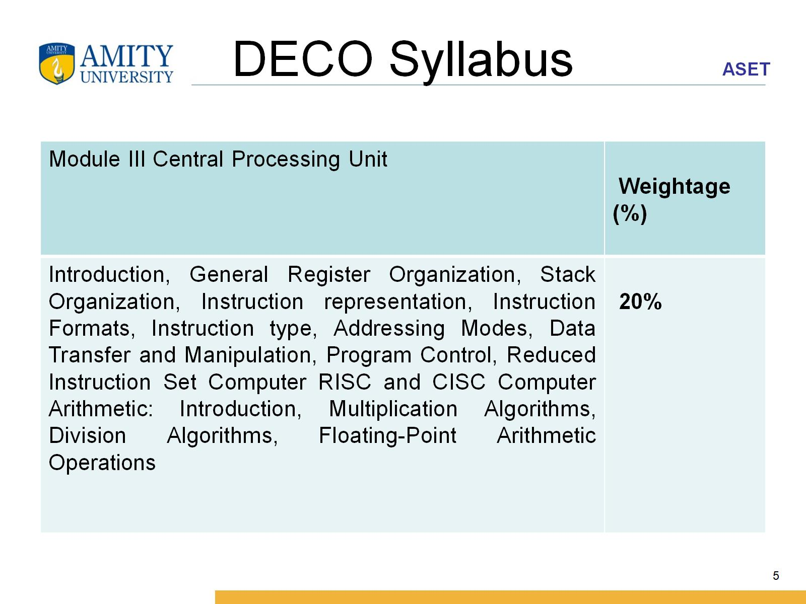
DECO Syllabus

Slide 6
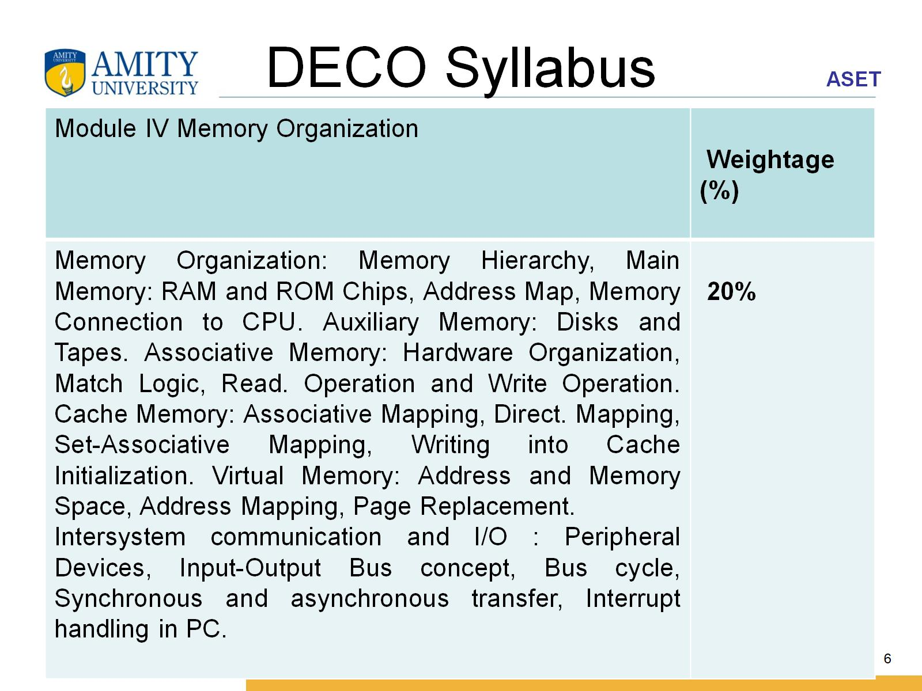
DECO Syllabus

Slide 7
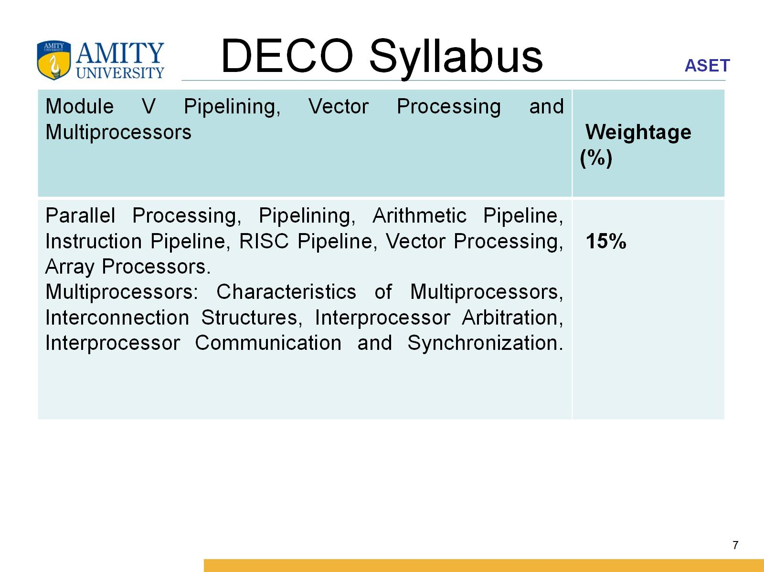
DECO Syllabus

Slide 8
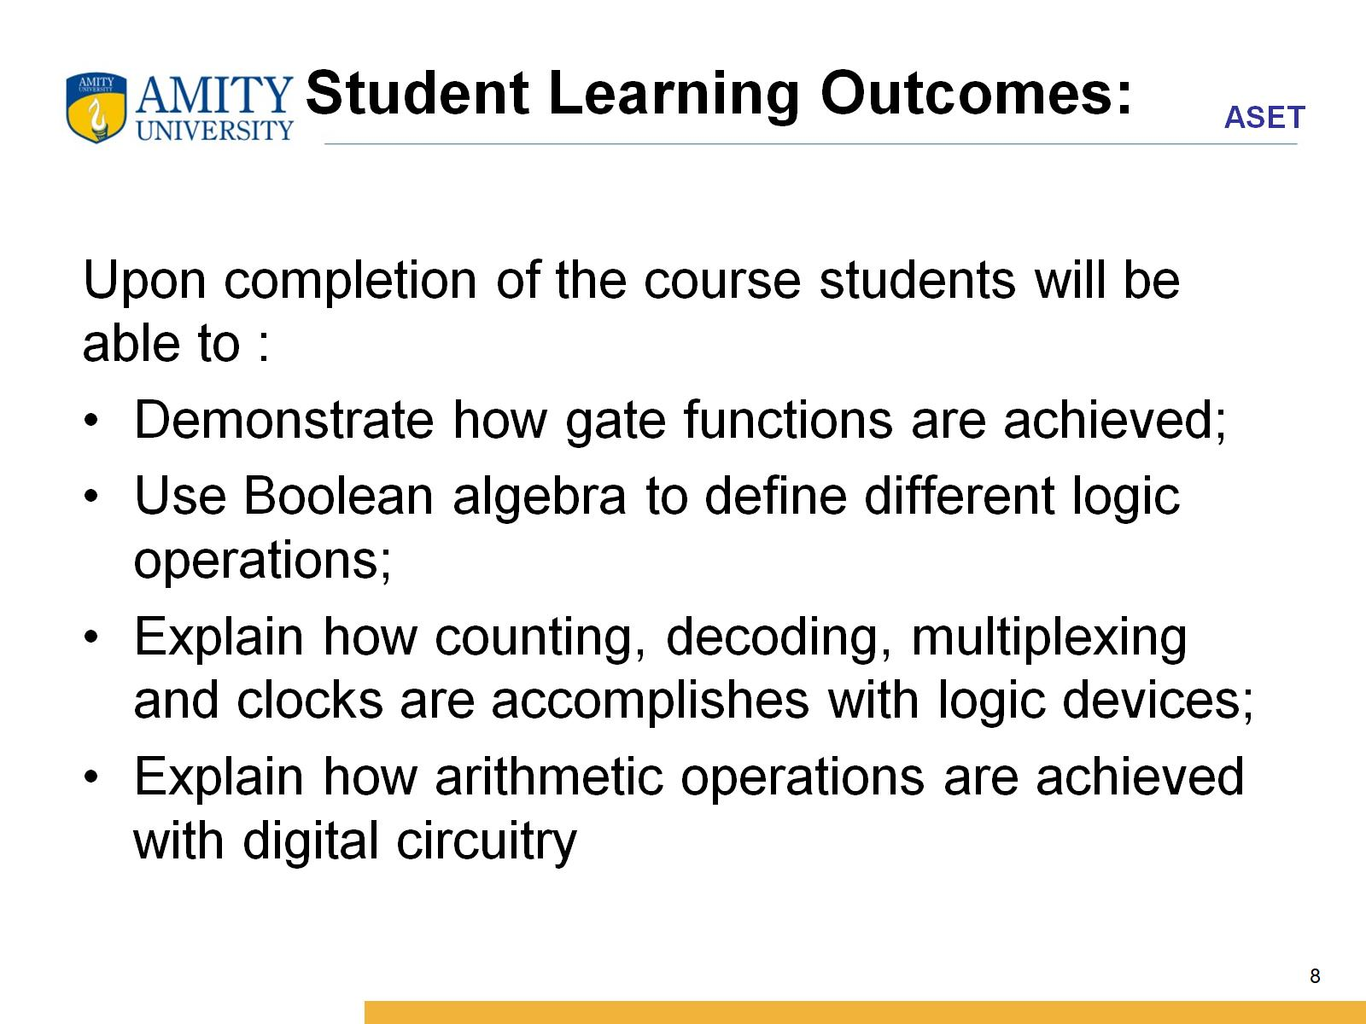
Student Learning Outcomes:

Slide 9
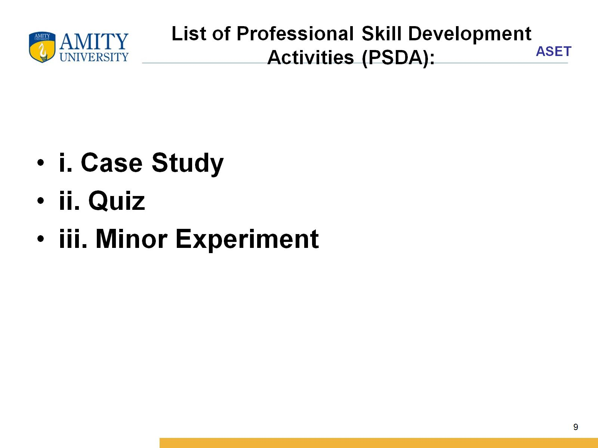
List of Professional Skill Development Activities (PSDA):

Slide 10
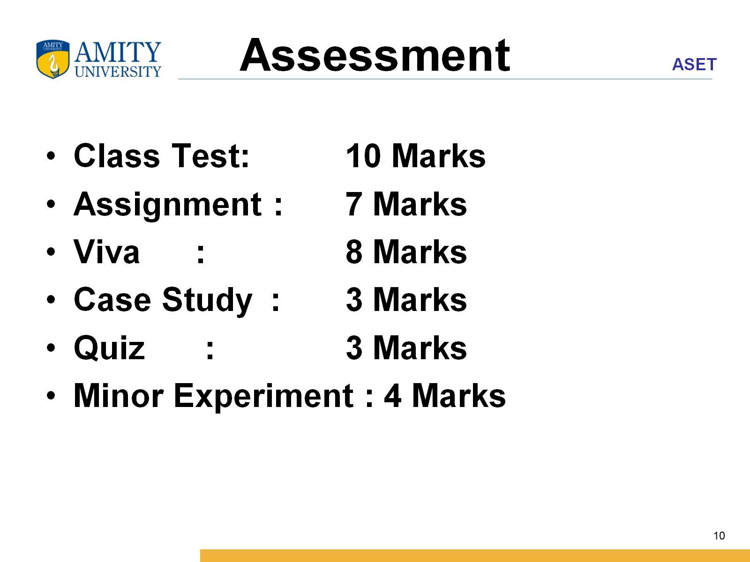
Assessment

Slide 11
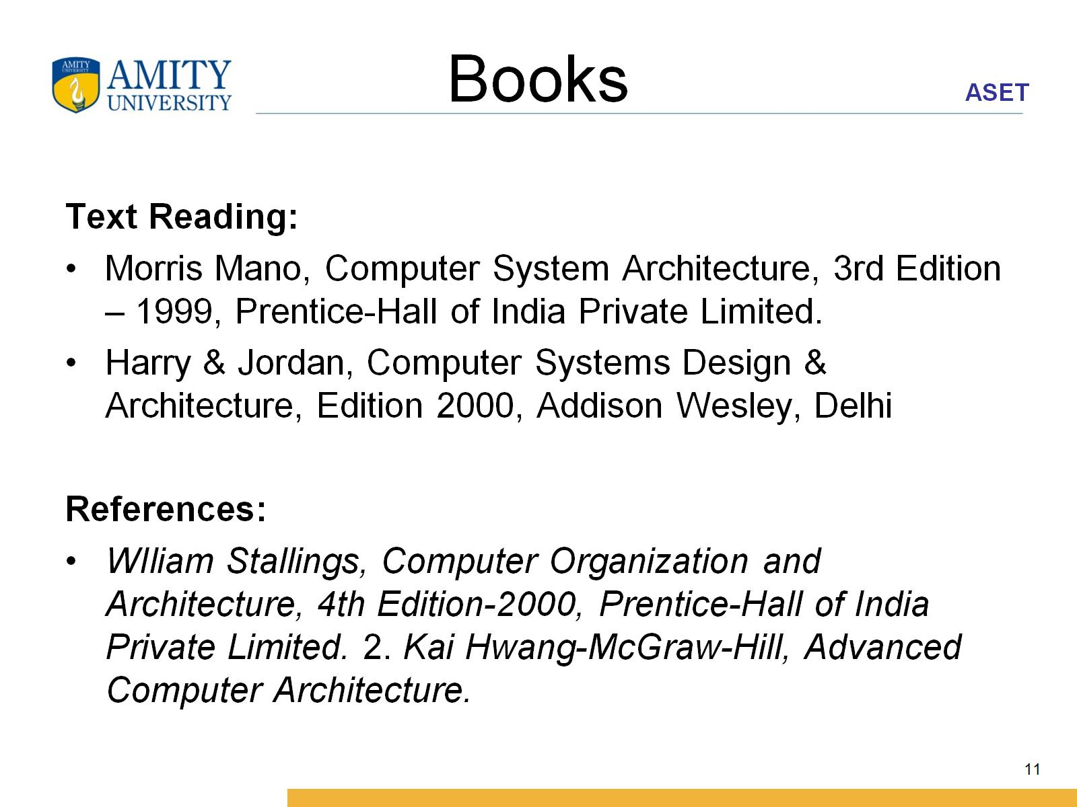
Books

Slide 12
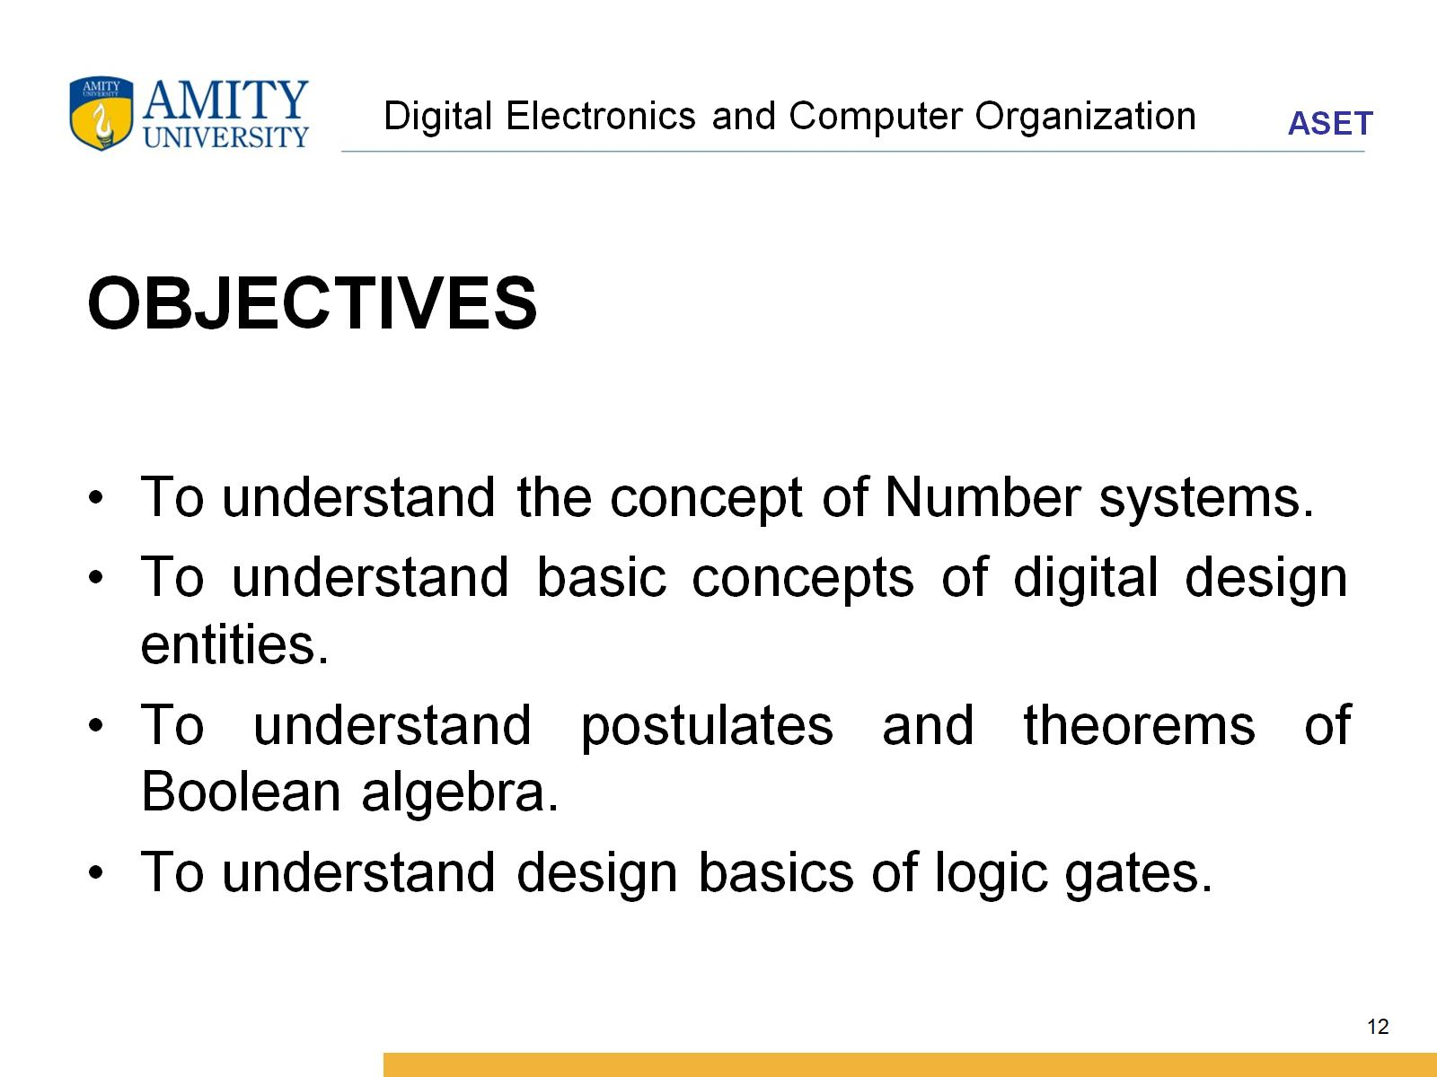
Digital Electronics and Computer Organization

Slide 13
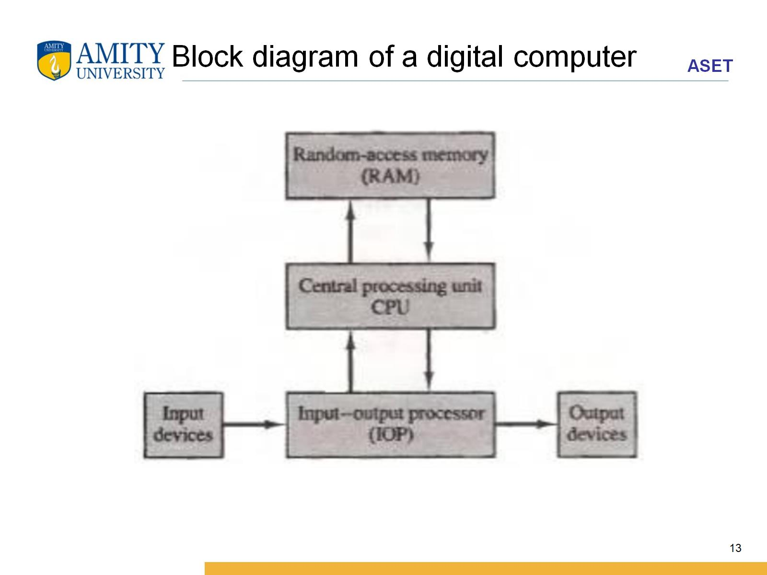
Block diagram of a digital computer

Slide 14
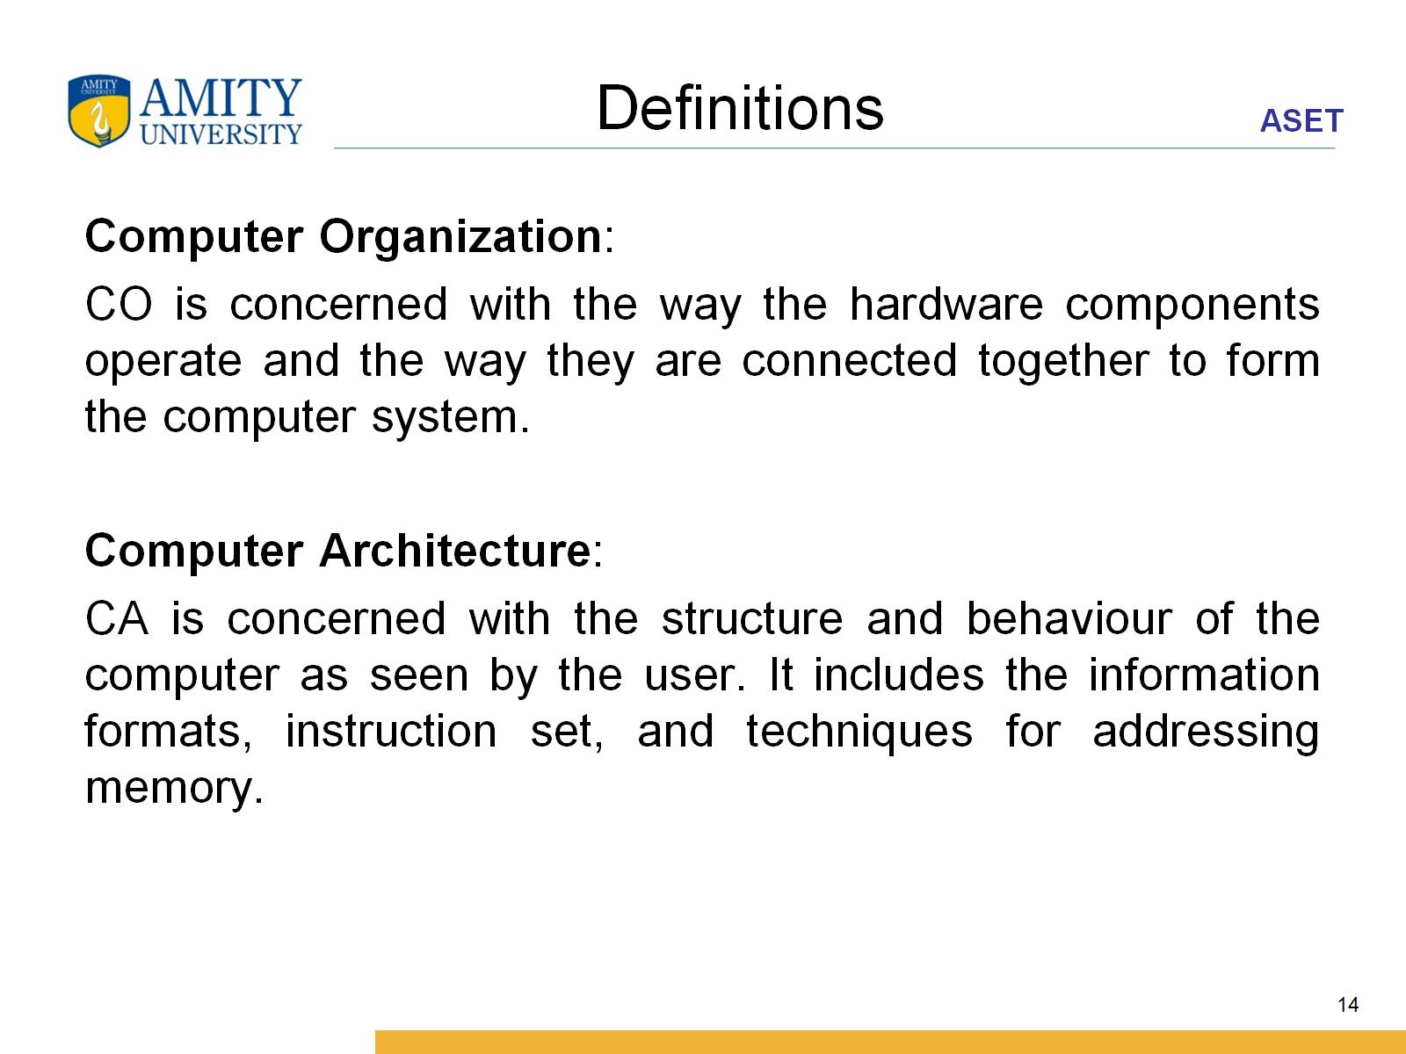
Definitions

Slide 15
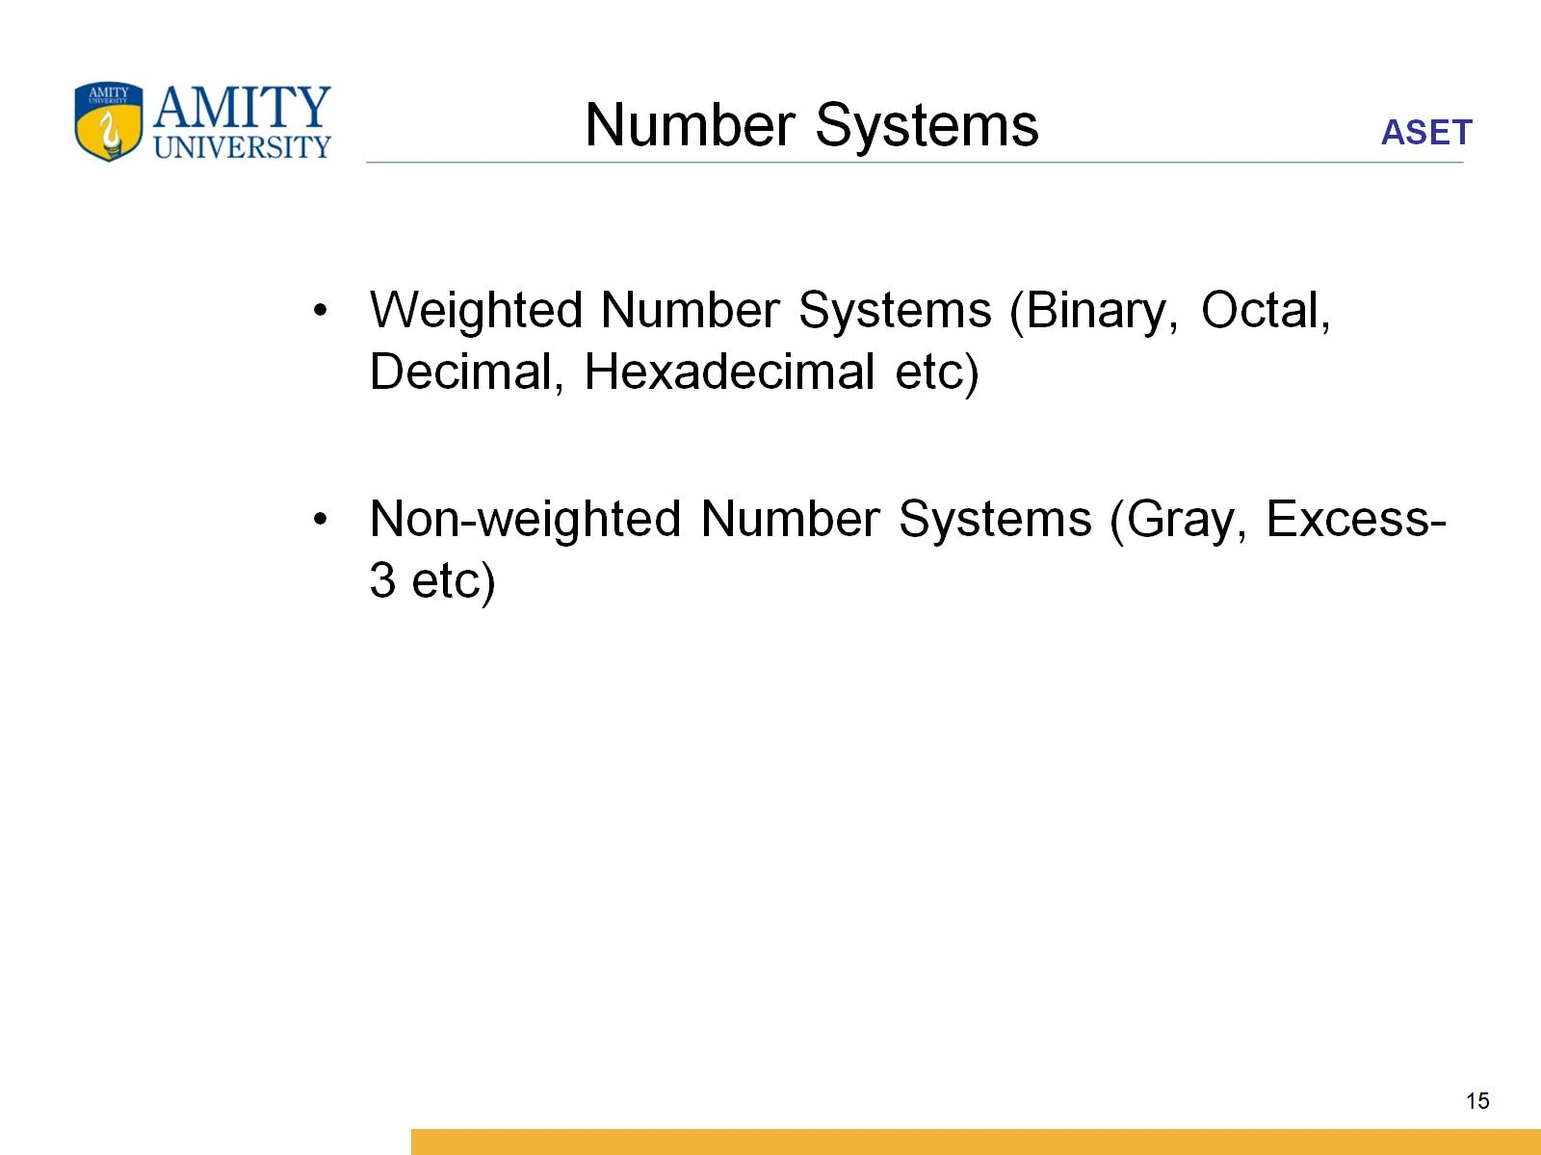
Number Systems

Slide 16
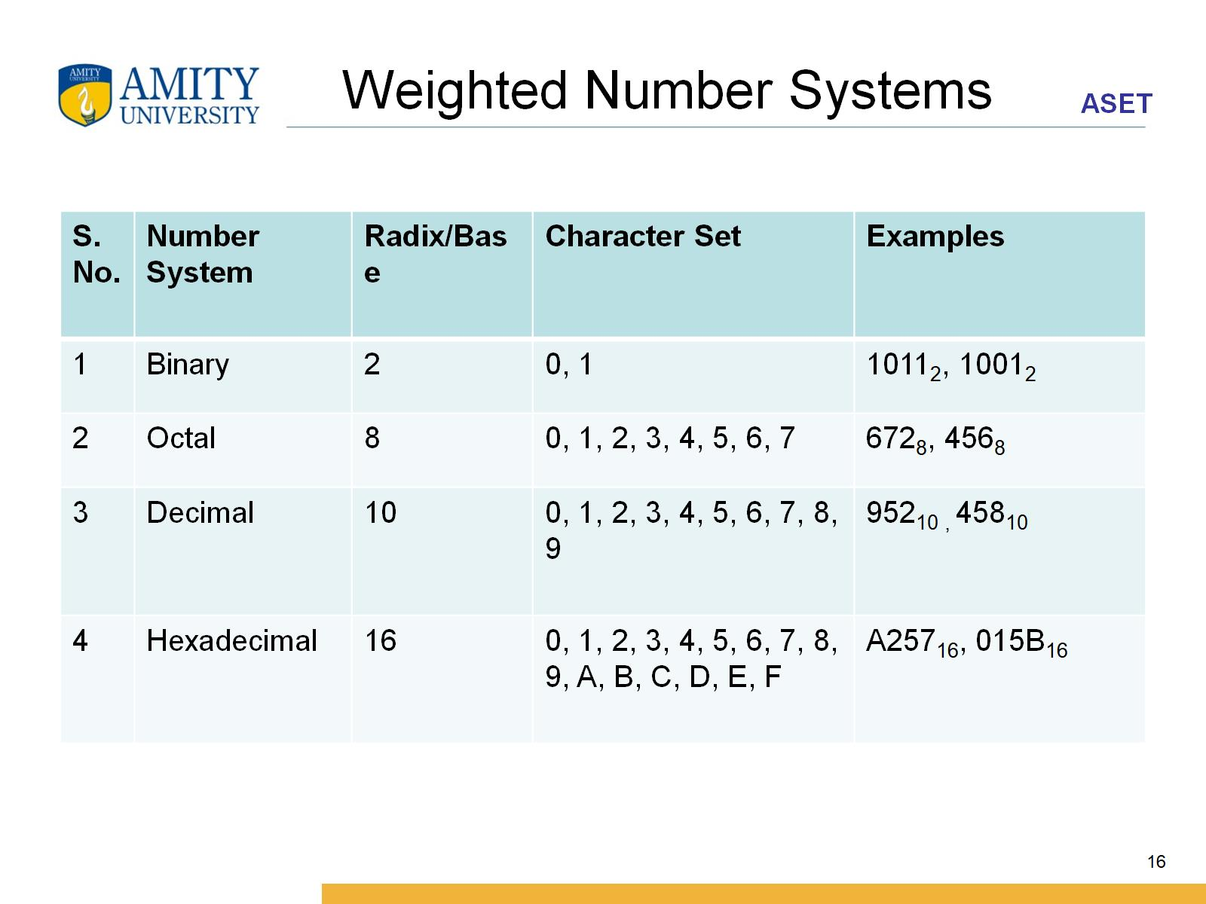
Weighted Number Systems

Slide 17
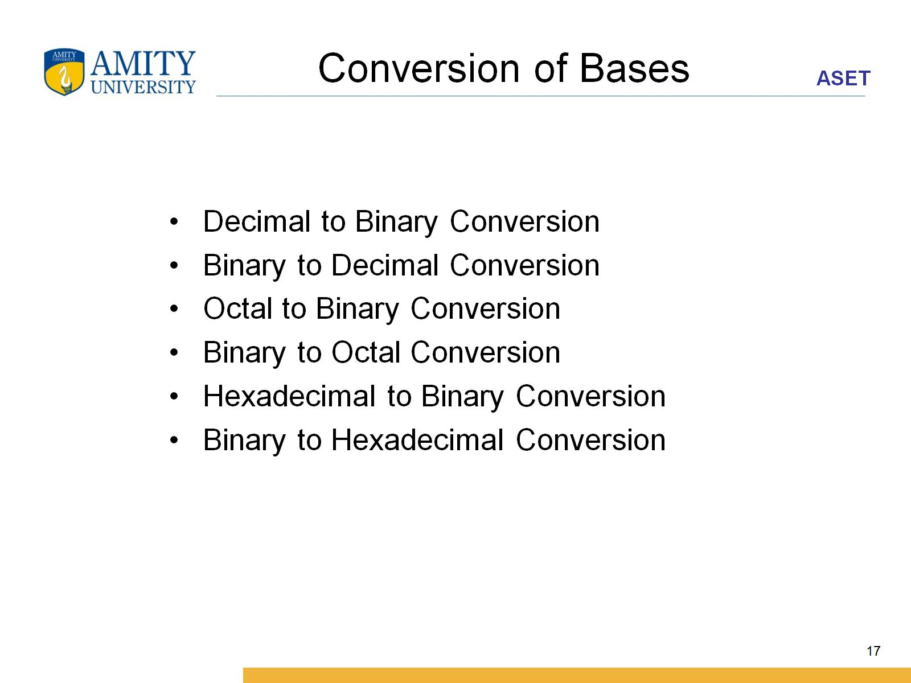
Conversion of Bases

Slide 18
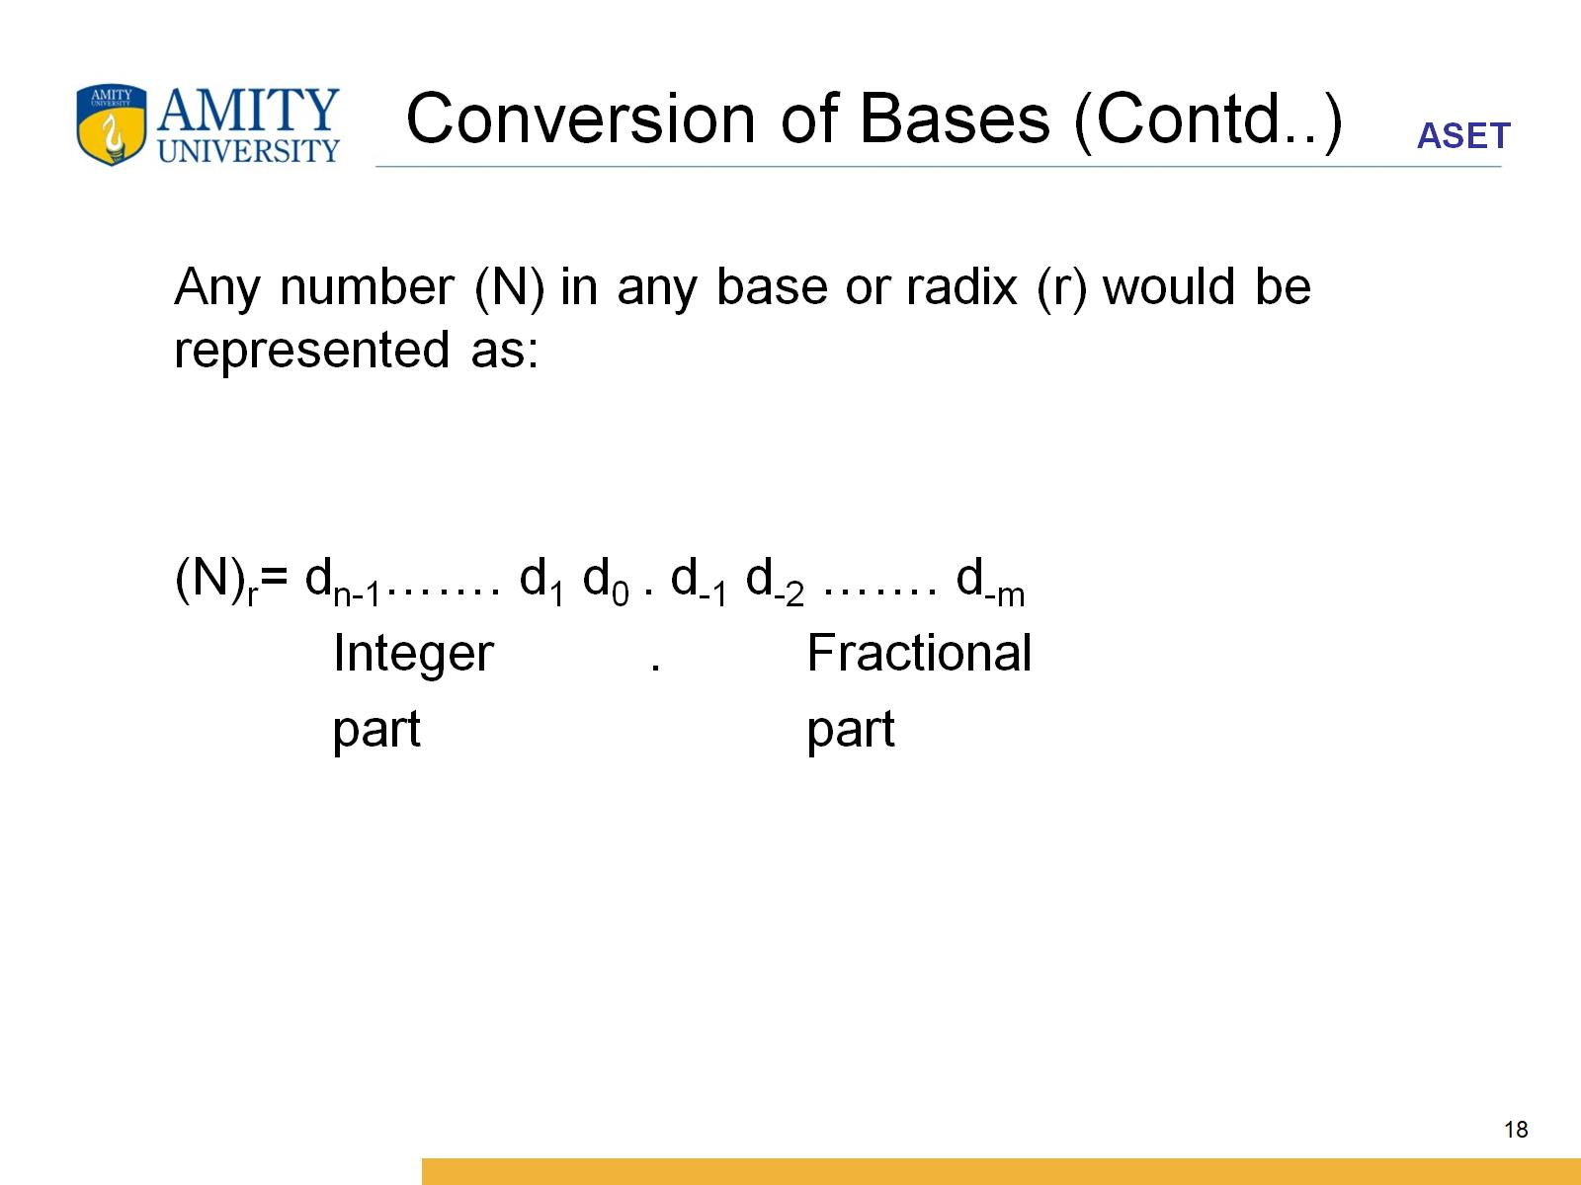
Conversion of Bases (Contd..)

Slide 19
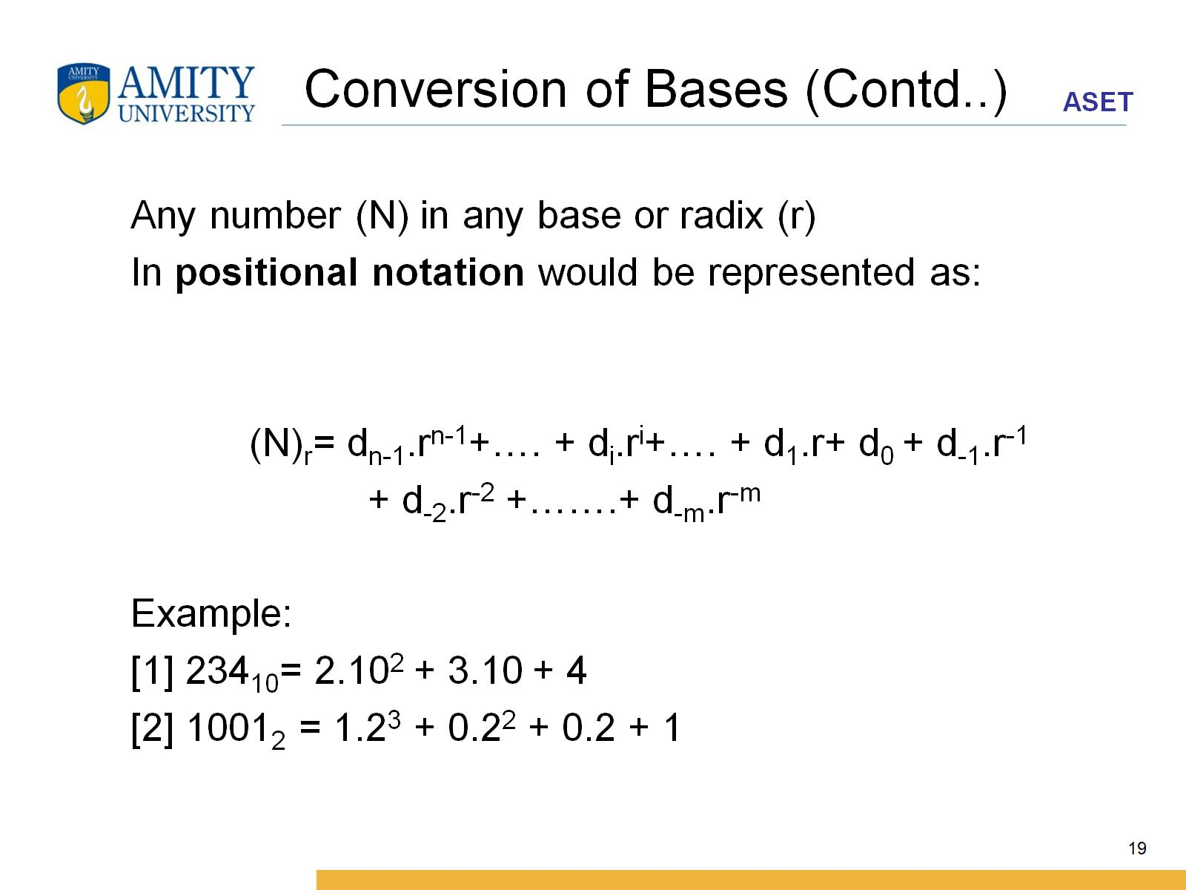
Conversion of Bases (Contd..)

Slide 20
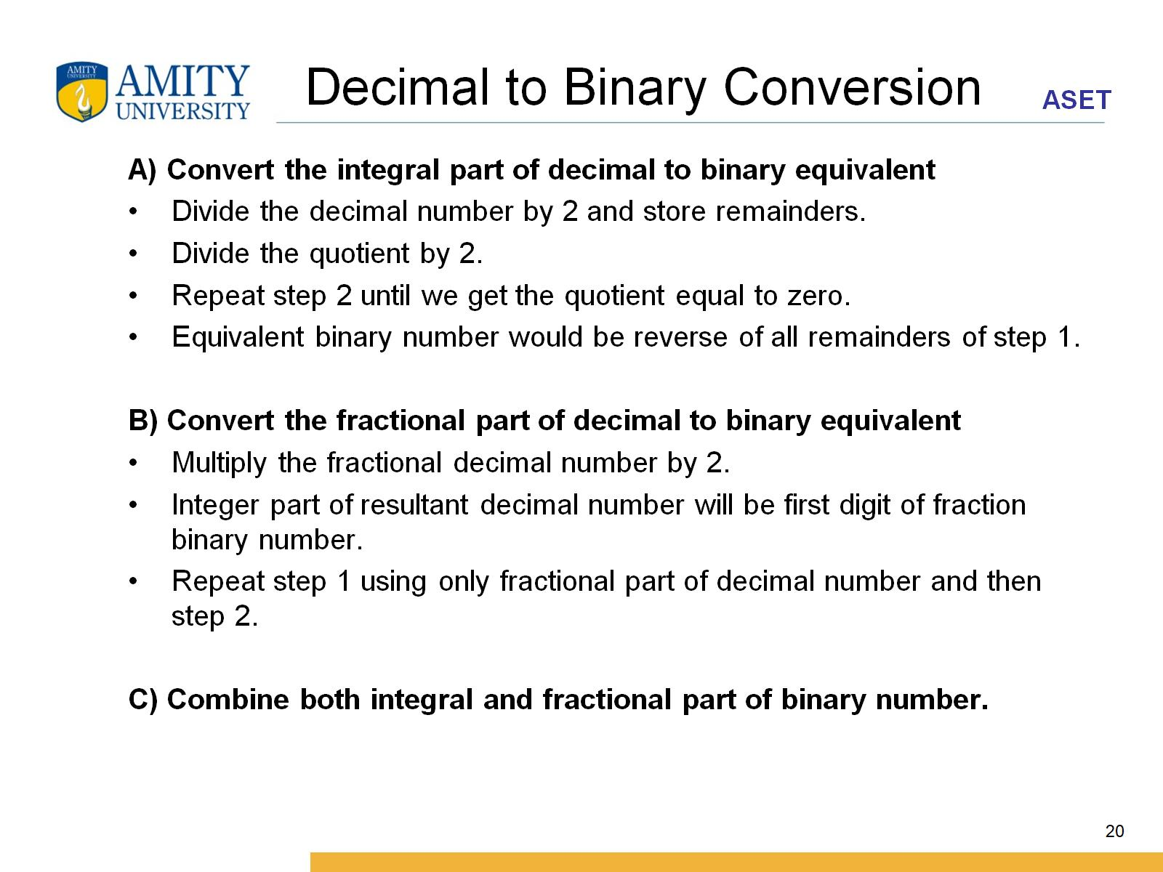
Decimal to Binary Conversion

Slide 21
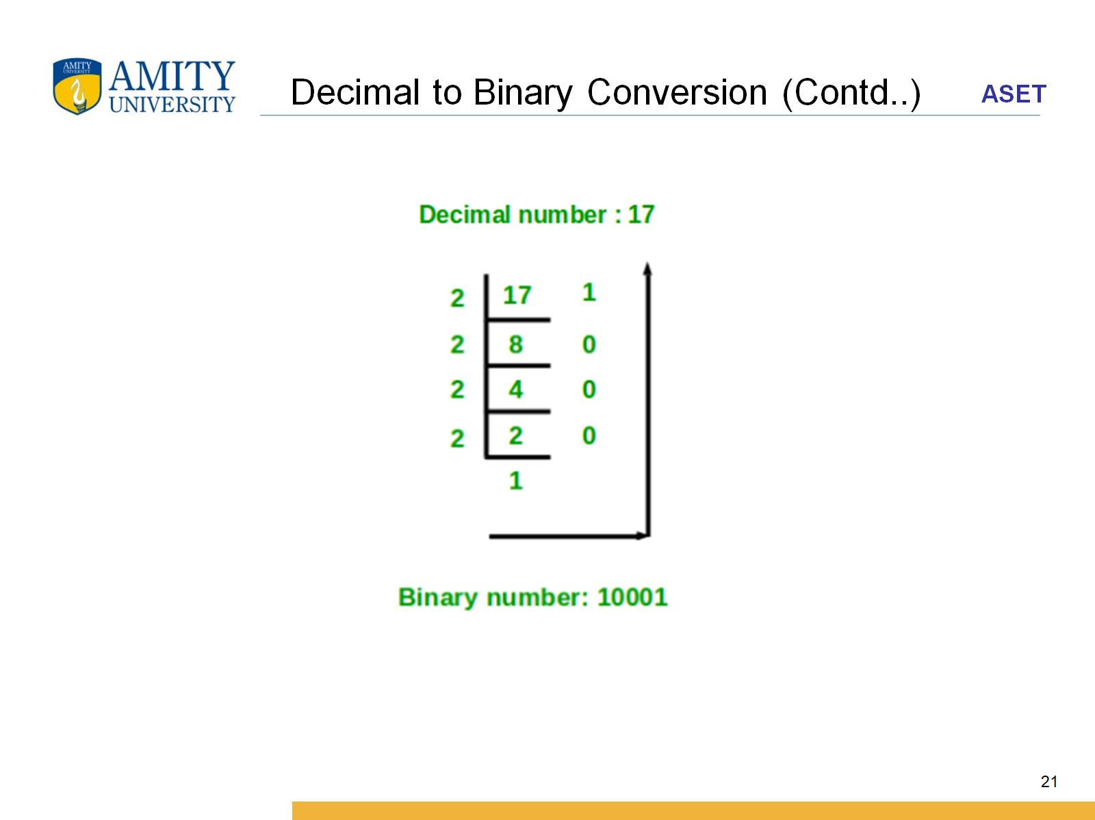
Decimal to Binary Conversion (Contd..)

Slide 22
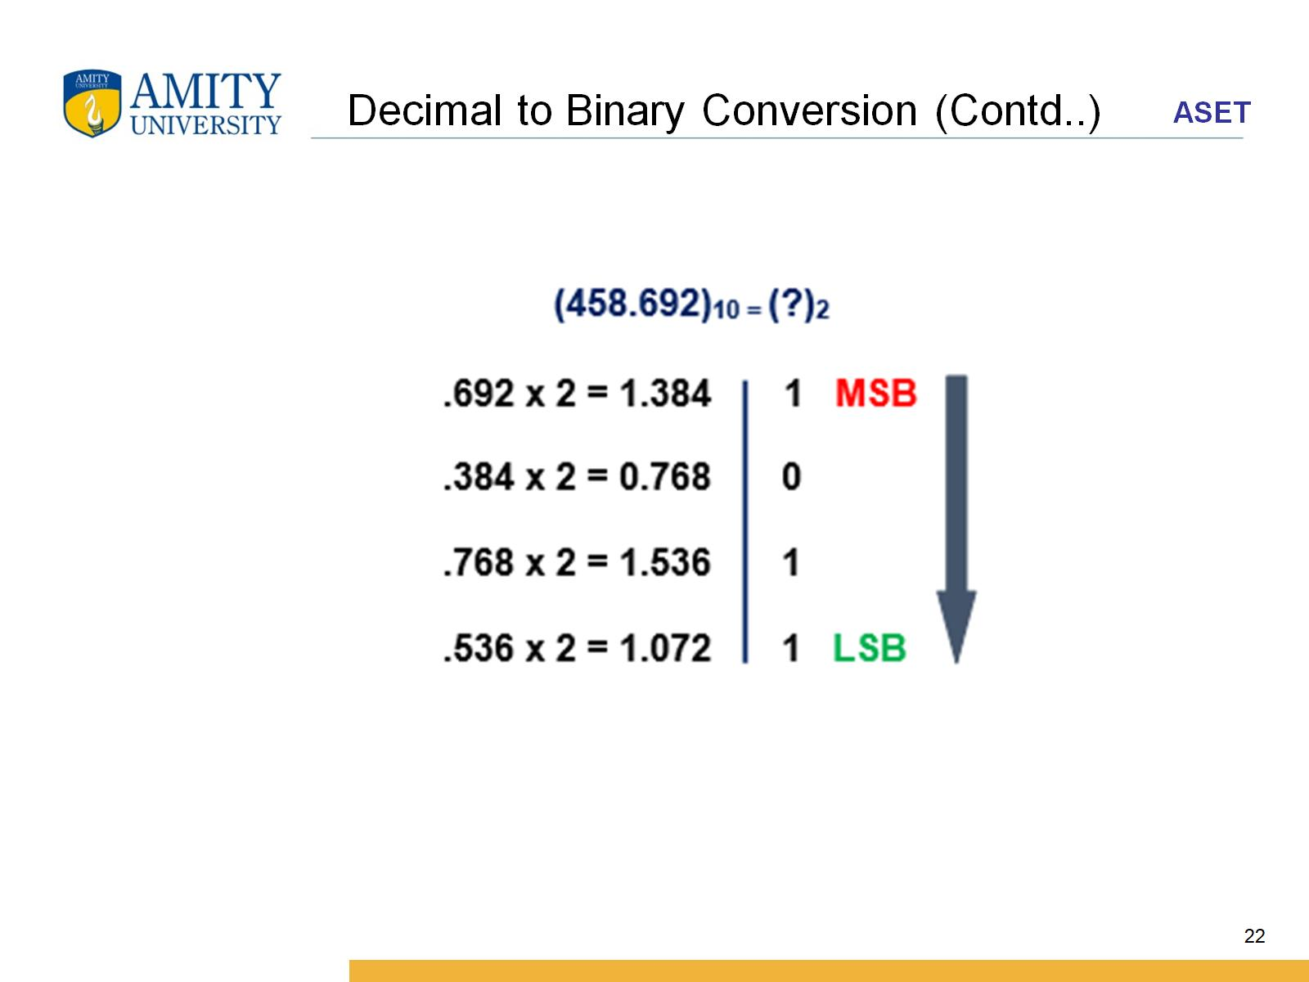
Decimal to Binary Conversion (Contd..)

Slide 23
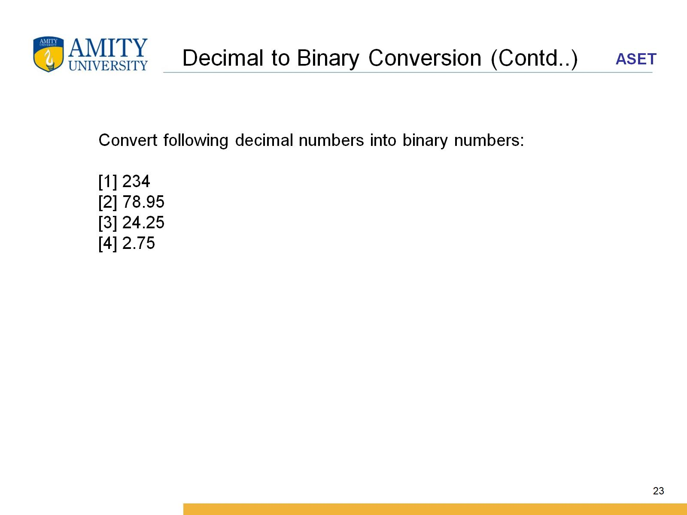
Decimal to Binary Conversion (Contd..)

